Slide 1
IC Chip: Automated Clay Target Scoring System
Client & Advisor: Dr. Henry Duwe, ECpE
Team Members:
Eva Kuntz - SE
Keith Snider - SE
Cole Huinker - CPrE
Steven Sleder - CPrE
Michael Ruden - EE
Philip Hand - EE
sdmay19-08
2 MAY 2019
Notes:
Eva

Slide 2
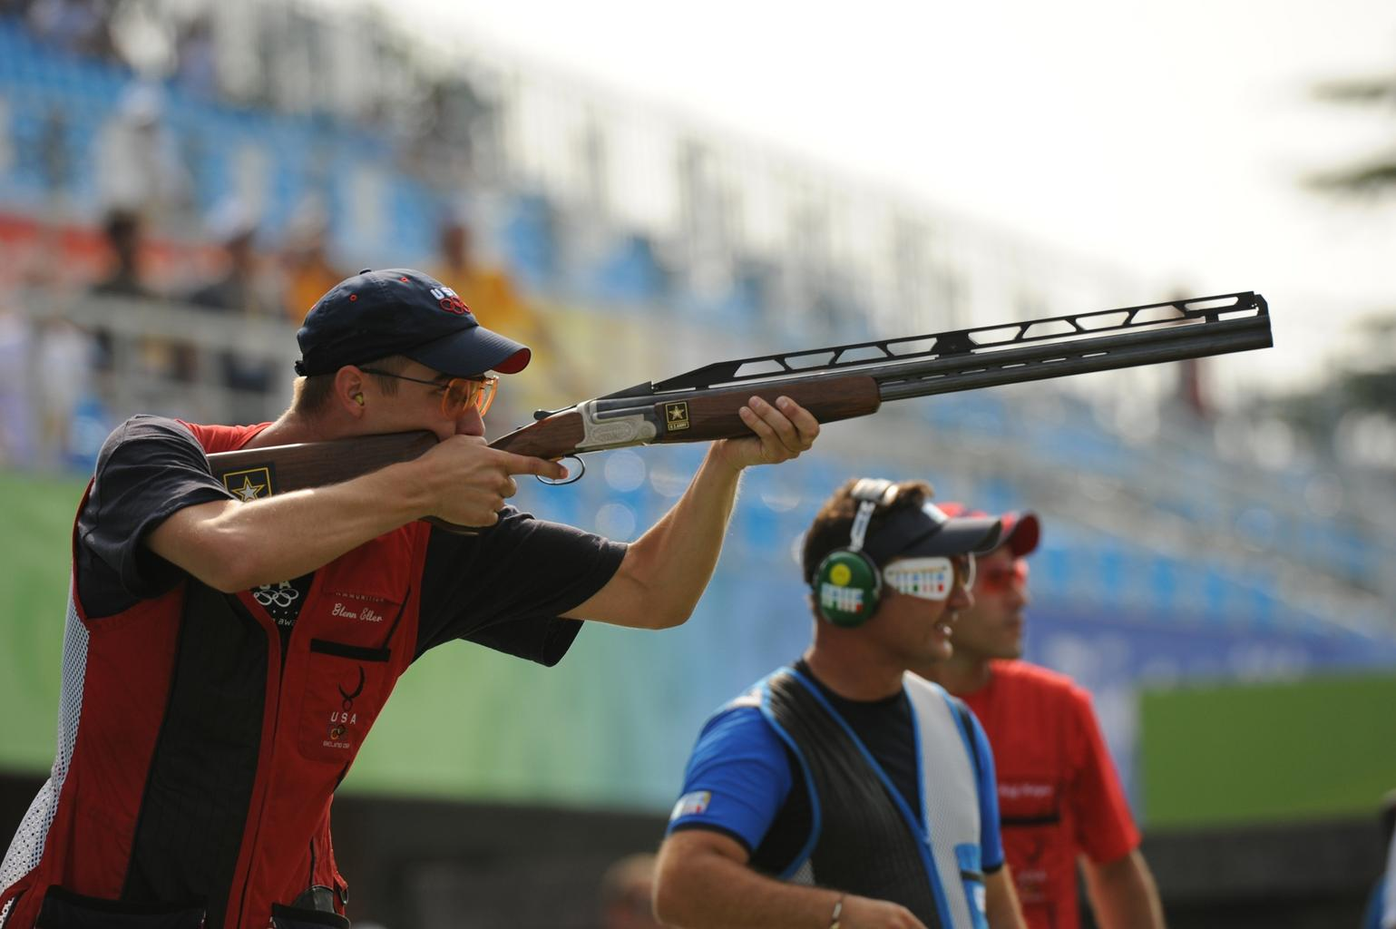
Problem
No automated scoring method for clay shooting sports (i.e. Skeet Shooting).
Current scoring requires individual with:
Exceptional eyesight
Knowledge about sport procedures and rules
Finding willing human referees is difficult
Skeet Shooting Tournament.
Public Domain: https://free-images.com/display/shooter_shooting_gun_rifle.html
Notes:
Steven

Slide 3
Importance of IC Chip
Similar Product: ShotKam
Camera attached to shotgun barrel.
Accompanying mobile app.
Tracks barrel movement.
Slow-motion replay.
Why it won’t solve our problem:
Expensive ($695/ShotKam)
Have to reattach ‘kam’ to each shooter’s gun.
Camera too narrowly focused.
Does not classify targets!
Notes:
Eva

Slide 4
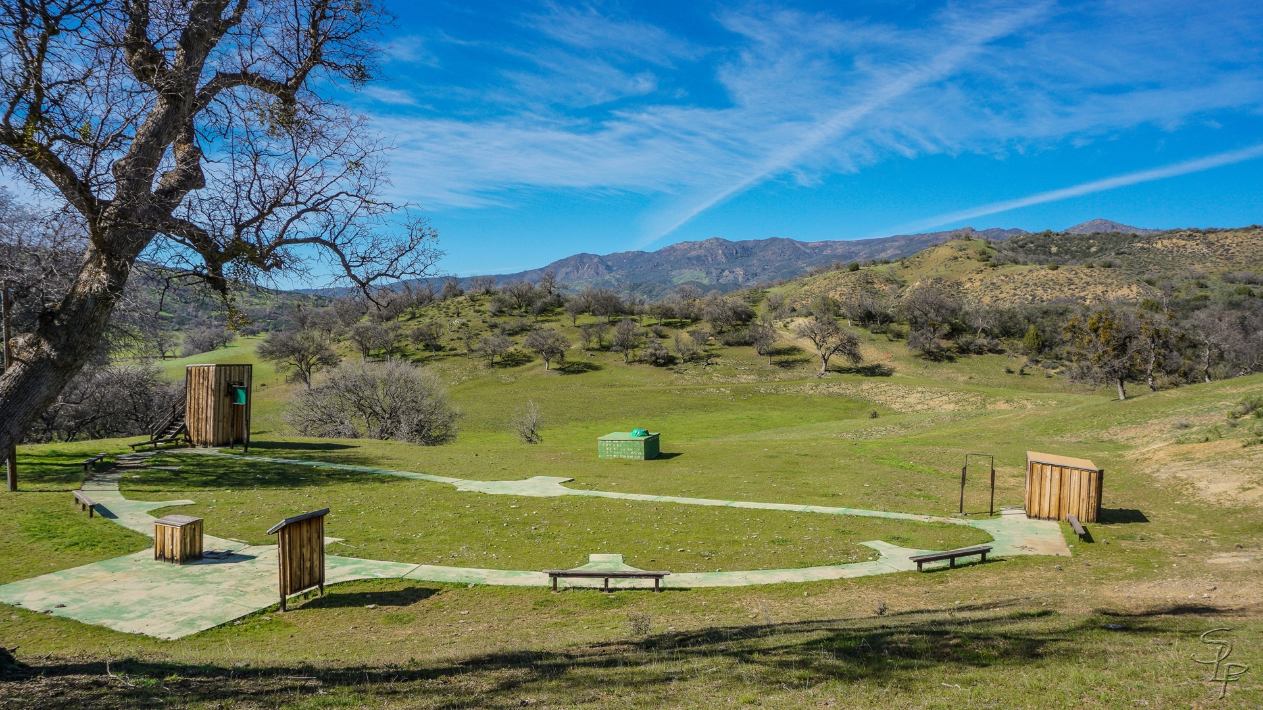
Operating Environment
Outdoor skeet shooting range
Various weather conditions
Strong wind v. light breeze
Day v. Night
Hazards:
Stray clay target pieces
Shotgun pellets
Range debris
Skeet Shooting Field.
Free Non-Commercial Use via Flicker User MichaelK91
Notes:
Mike

Slide 5
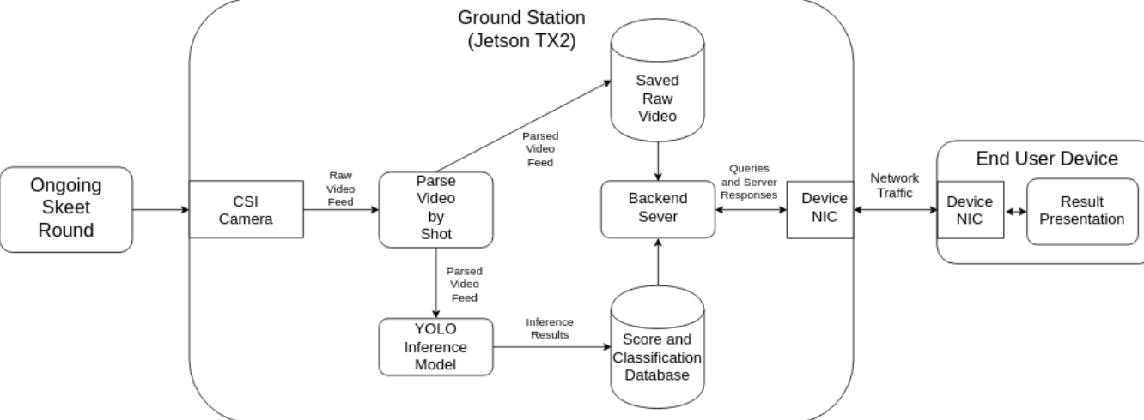
System Conceptual Sketch
System Conceptual Sketch.
Notes:
Steven

Slide 6
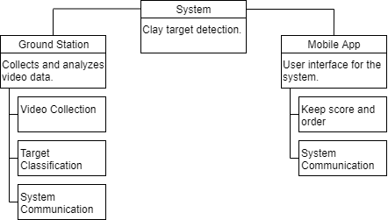
Functional Decomposition
System Function Decomposition
Notes:
Cole

Slide 7
Functional Requirements: Ground Station
The physical device should…
Produce its own WiFi signal.
Be accompanied by a protective, yet removable housing
Classify a clay target as DEAD or LOST.
Distinguish between a clay target fragment and shotgun wad or other debris.
Notes:
Eva
***Only presenting core project requirements

Slide 8
Functional Requirements: Mobile Application
The mobile application should...
Create and start shooting sessions.
Allow users to update scores in the scorecard.
Allow users to review video footage.
Allow users to challenge a target classification.
Allow users to start and stop the ground station from recording.
Allow users to exit and return to app w/o starting over
Notes:
Eva

Slide 9
Application Development
Xamarin.Android
Activities
Fragments
Models
Layout

Slide 10
User Interaction
Android Application:
User creates and starts Shooting Session.
User controls shooting session
User can challenge target classification.
User views shot video only if target challenged.
User can overturn target classification.
Ground Station:
User sets up ground station.
User powers on ground station.
*Majority of user interaction is with mobile application!
Notes:
Keith

Slide 11
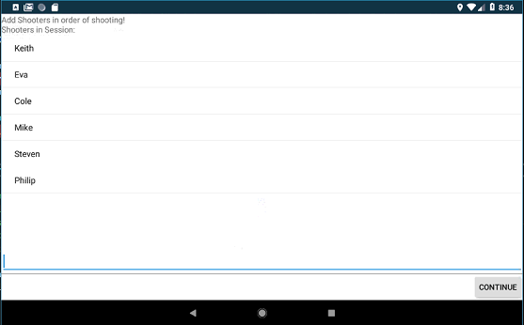
Adding Shooters to Session
Notes:
Keith

Slide 12
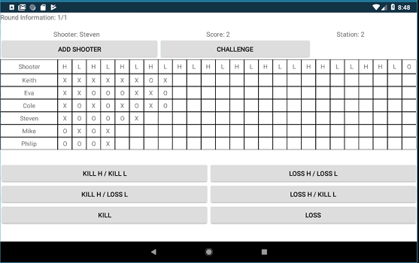
Shooting Session
Notes:
Keith

Slide 13
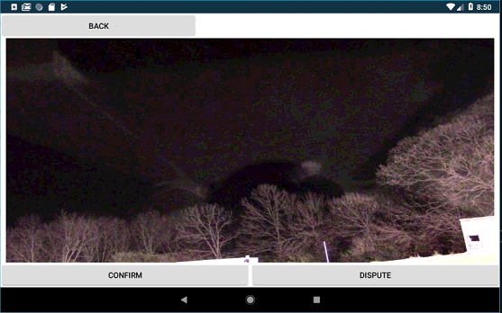
Video Review
Notes:
Keith

Slide 14
Backend
Flask
API calls to fetch data
Camera Control
Handled through the API
Analysis
Checks whether whether target came from high house or low house
Notes:
Cole

Slide 15
Backend Pipeline
Notes:
Cole

Slide 16
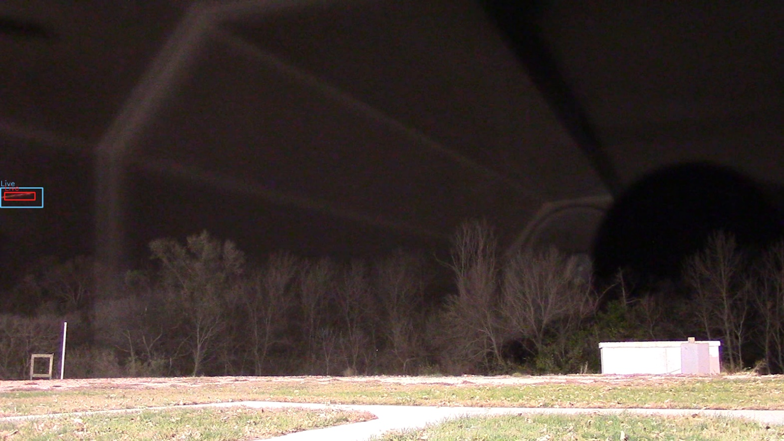
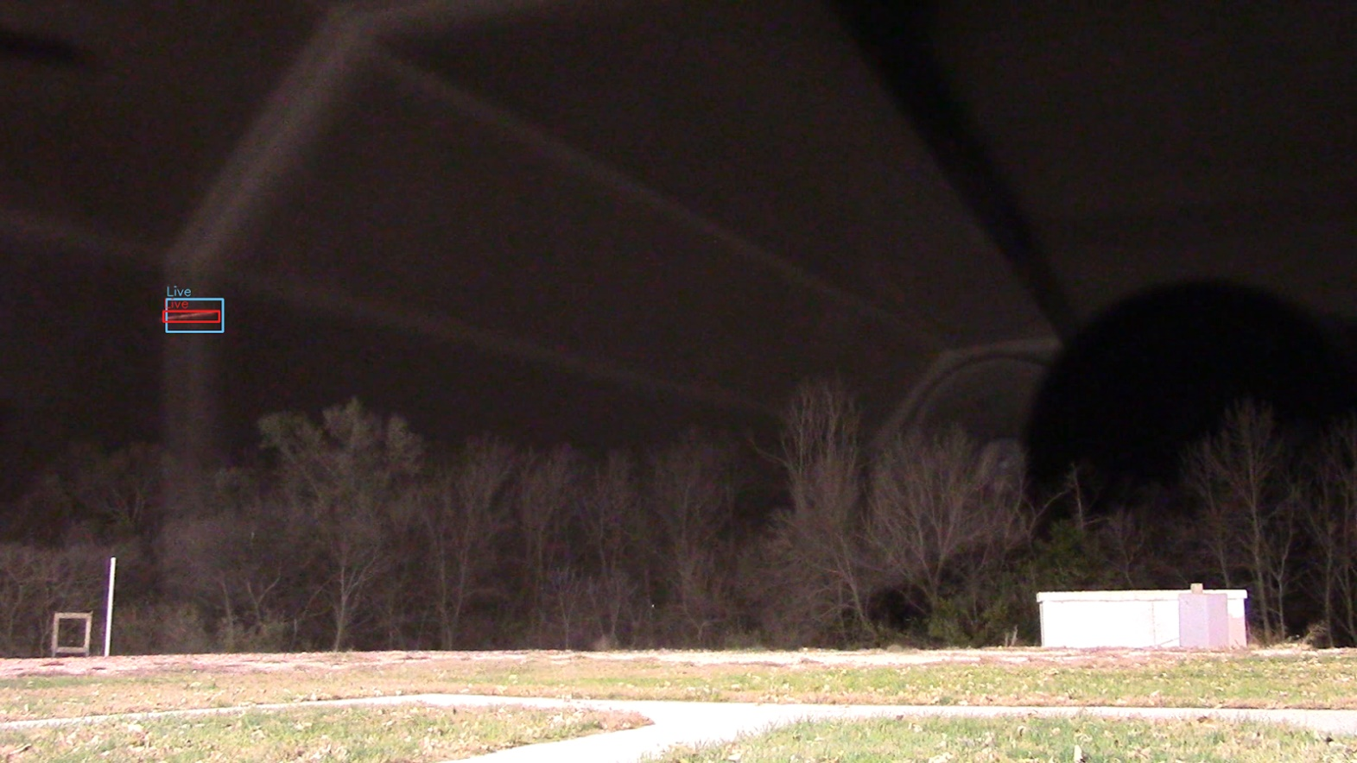
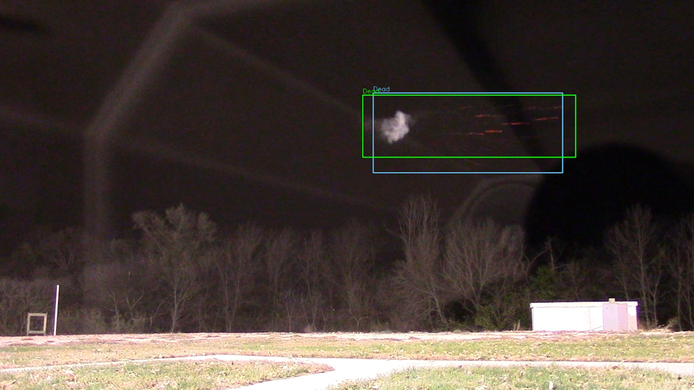
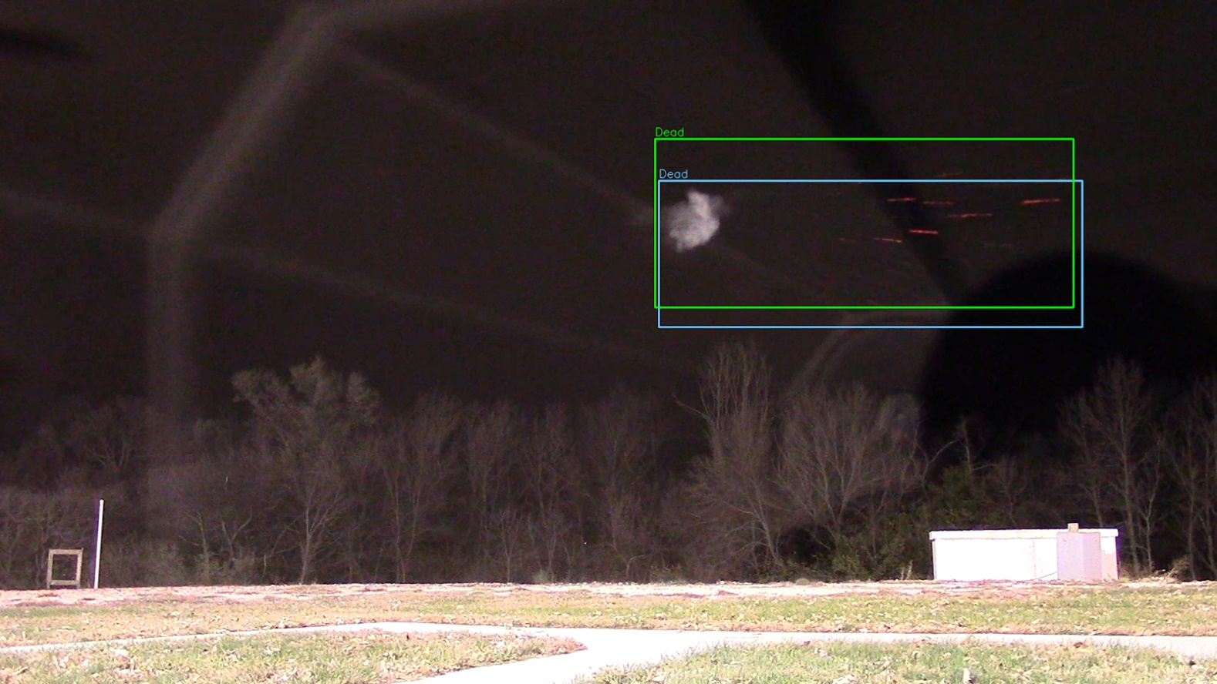
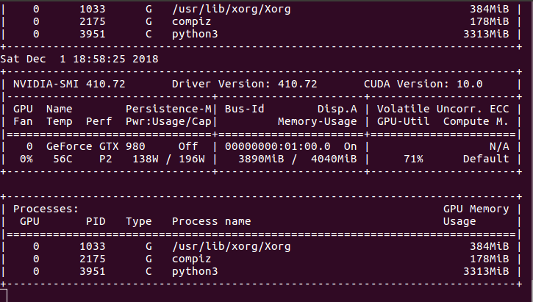
Model
AlexeyAB’s You Only Look Once, version 3
State-of-the-art object detection and tracking
Highly-tunable hyperparameters to fit limited resource requirements
Excellent solution for a supervised machine learning problem
Fork of the original algorithm with additional functionality and active maintainers
Excensible C/C++ Implementation
YOLOv3 in Action
YOLOv3 Resource Consumption
Notes:
Steven

Slide 17
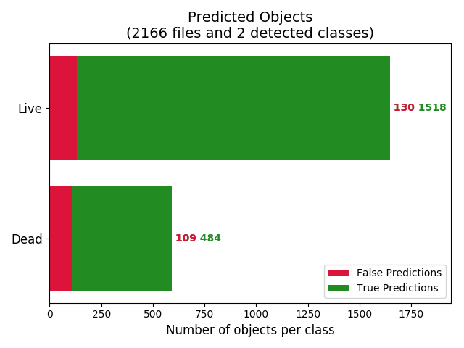
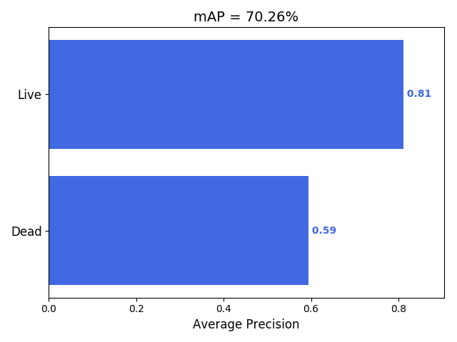
Data Collection and Training
No Dataset Previously Existed
Collected ~4 hours of raw video on two occasions
Split into individual frames
Manually label as Dead or Live
8795 final labeled images
Split into Disjointed Training and Testing Sets
6639 Training Images
2166 Testing Images
Approximately even distributions of Live and Dead
Training Times of 5-9 Days for Each Model
Due to lack of compute resources
Nearly Satisfactory Performance on Testing Set
91.4% for Live
77.4% for Dead
Mean Average Precision and Prediction Accuracy
Notes:
Steven - Training Data

Slide 18
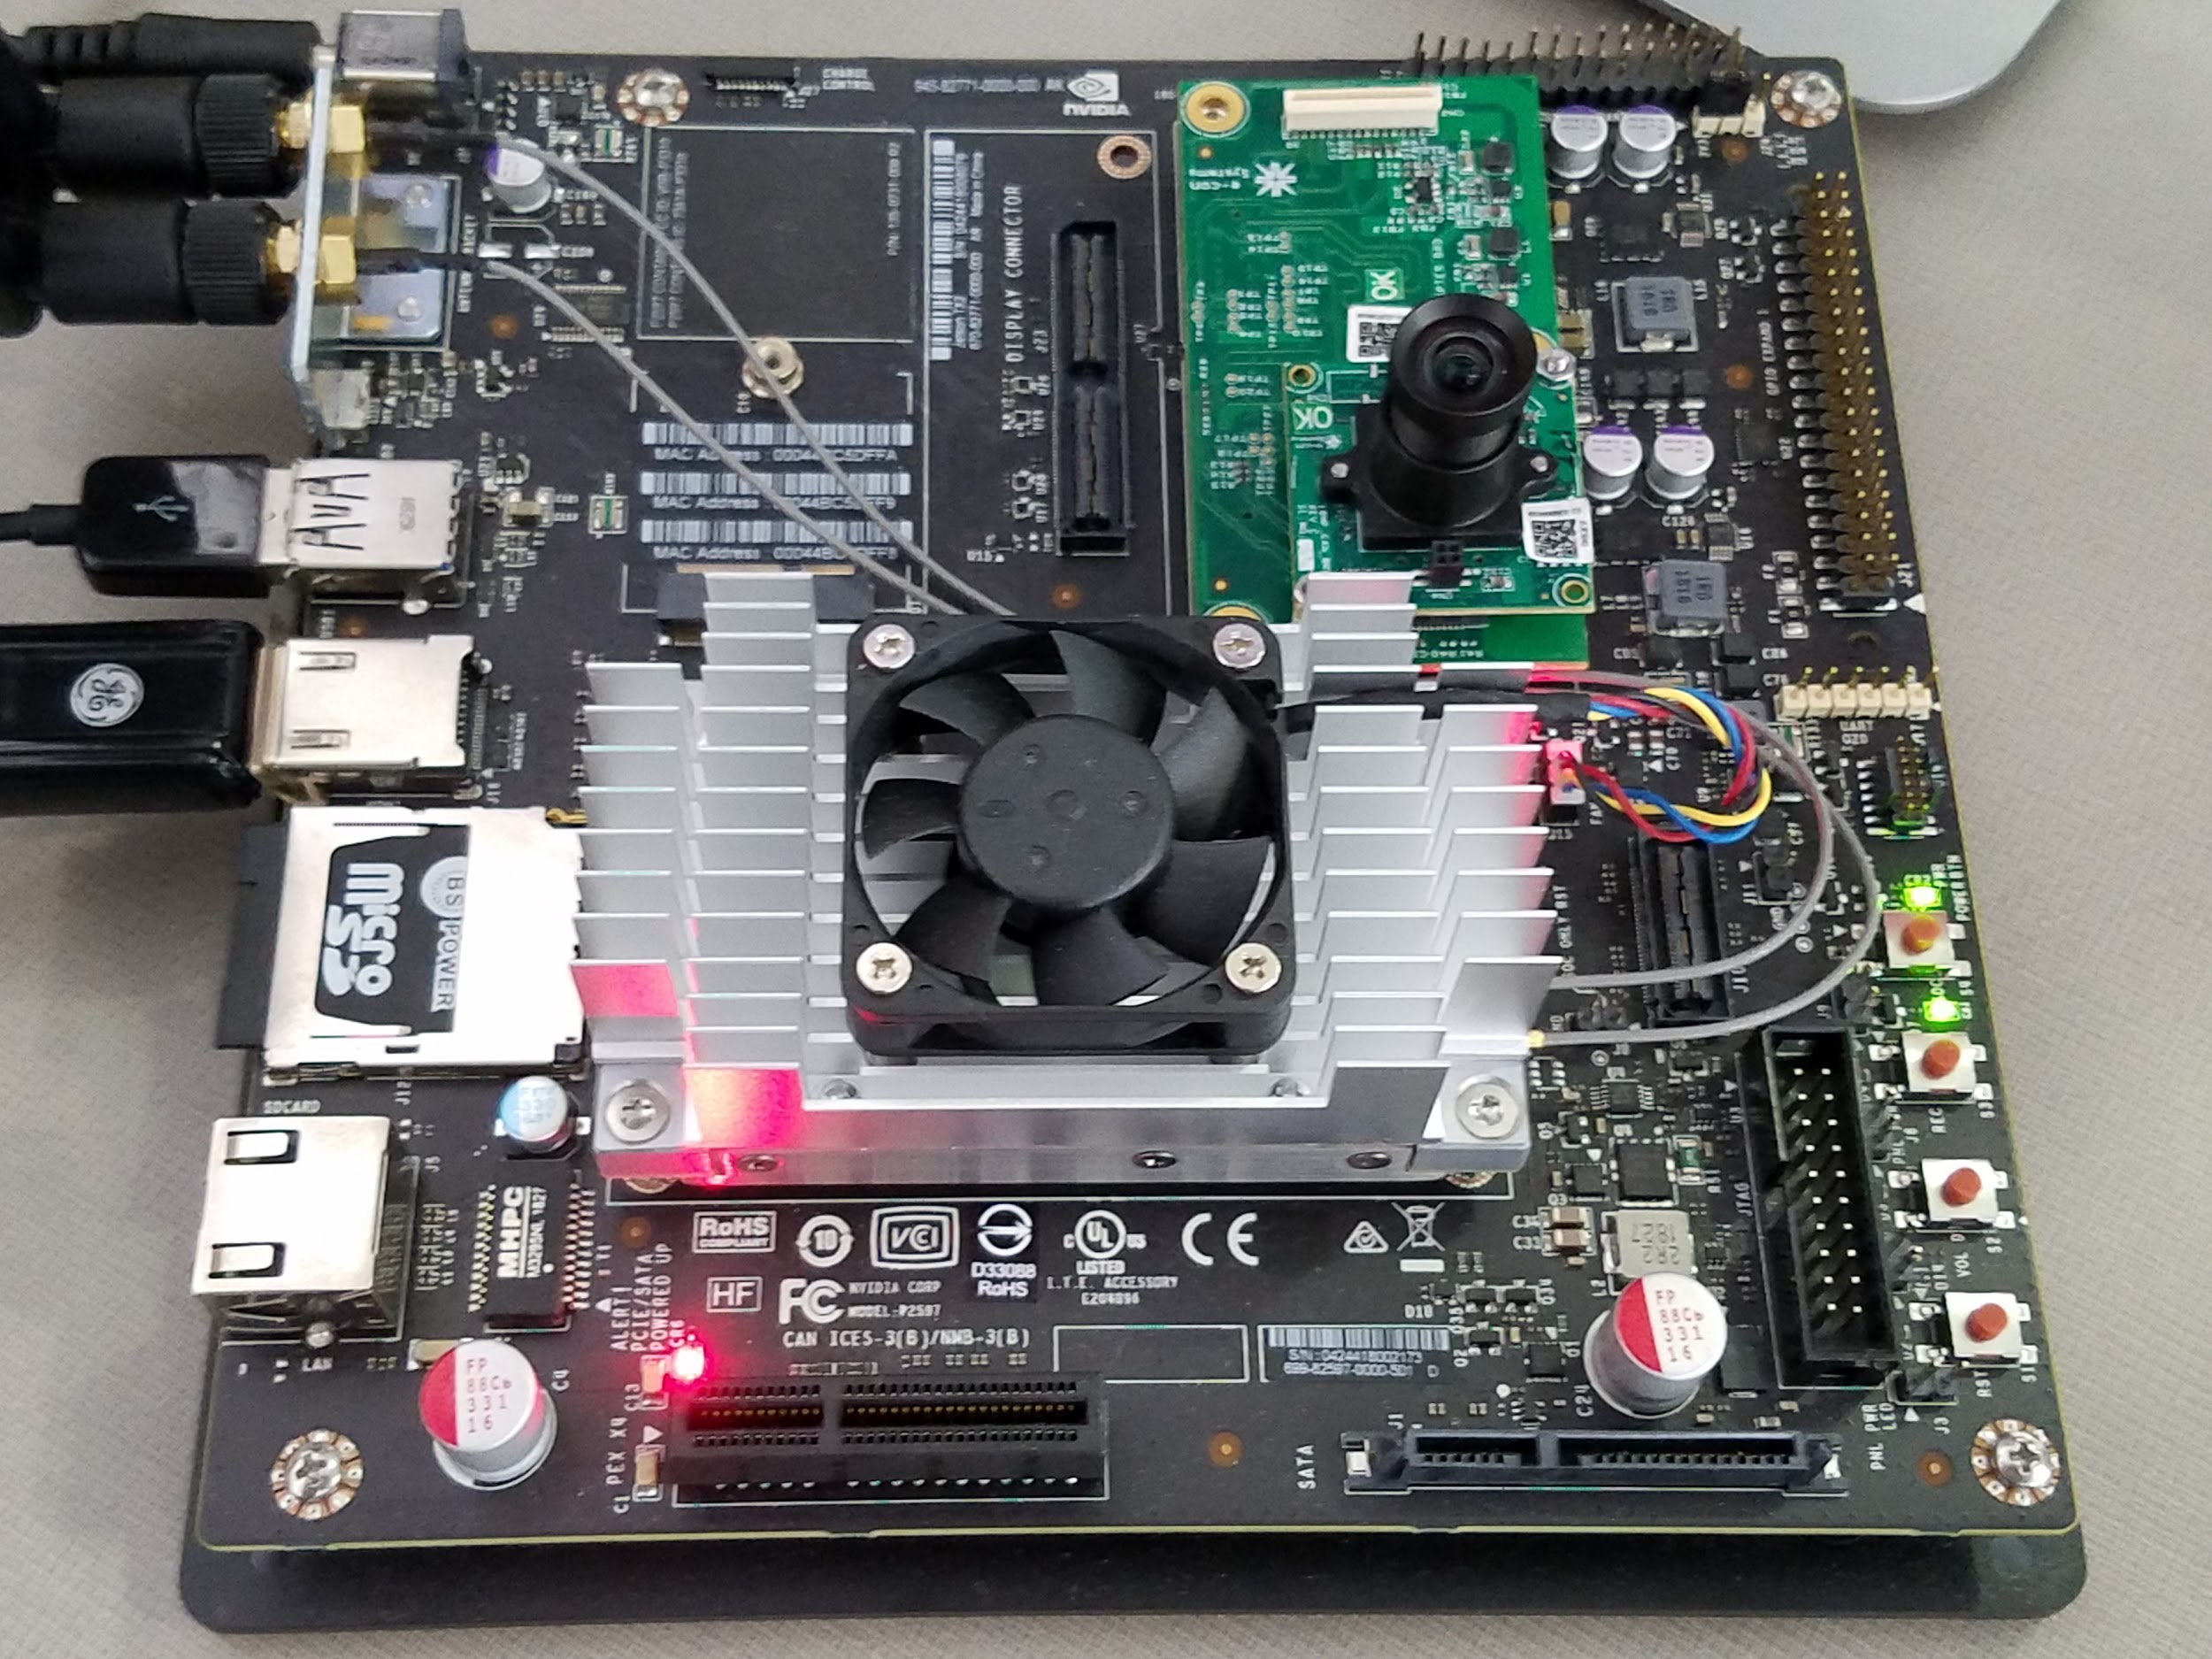
Hardware
Nvidia Jetson TX2 Developer Kit
256 CUDA Pascal Cores
8 GB LPDDR4
Numerous ports for expansion
Small footprint
e-CAM130 CUTX1
Compatible w/ Jetson through high speed 4-lane MIPI CSI-2 interface.
4912(H) x 3684(V) resolution
72° FOV w/ changeable S-mount lens.
Full capture control through software.
Jetson TX2 Developer Kit with mounted e-CAM130 CUTX1
Notes:
Steven - Jetson
Mike - Camera

Slide 19
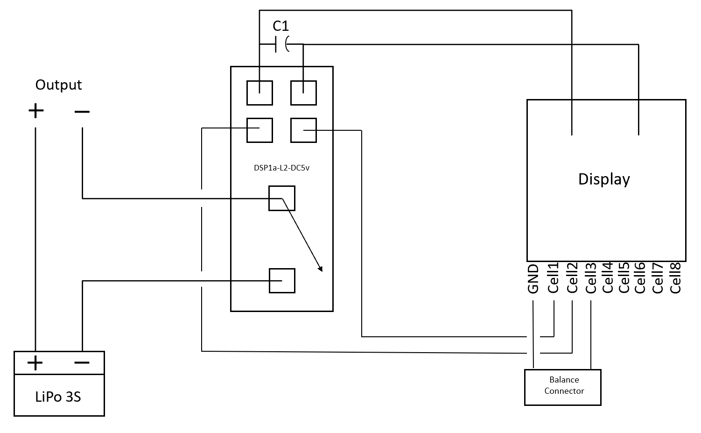
Power Options
Power Adapter
Wattage: 60W, Voltage: 19V, Amperes: 3.16 A
Battery Power Alternative
2 x 5000 mAh LiPo 3s Batteries
Capable of powering ground station 8 hours
Circuit Protections Needed
Over Discharge Protection Circuit
Overcurrent Protection circuit
Over Discharge Protection Circuit
Notes:
Philip

Slide 20
Looking Forward...
Algorithmically Handle Multiple Targets
Ground station tracks what the current shooter’s position is
Examine and Improve the Robustness of the Model
How well does it perform in real time on a live range?
Is its performance invariant to different conditions such as lighting and background?
Additional System Integration
Increase the functionality offered by the backend
Fully integrate backend with the application.
Develop a Rugged System Housing
Battery added to Jetson
Notes:
Steven, Keith, Cole

Slide 21
Individual Member Contribution
Eva Kuntz
Mobile Application design and development
Project manager
Keith Snider
Mobile Application development and testing
Mobile Application requirements elicitation.
Cole Huinker
Data collection lead
Back end development
Steven Sleder
Computer vision model construction
Data labelling documentation and organization
Michael Ruden
Camera selection
Hardware Integration
Philip Hand
Power
Data labeling
Notes:
ALL

Slide 22
Questions?

