Slide 1
IC Chip: Automated Clay Target Scoring System
Client & Advisor: Dr. Henry Duwe, ECpE
Team Members:
Eva Kuntz - SE
Keith Snider - SE
Cole Huinker - CPrE
Steven Sleder - CPrE
Michael Ruden - EE
Philip Hand - EE
sdmay19-08
December 3rd, 2018
Notes:
Philip
[Backup: Keith]

Slide 2
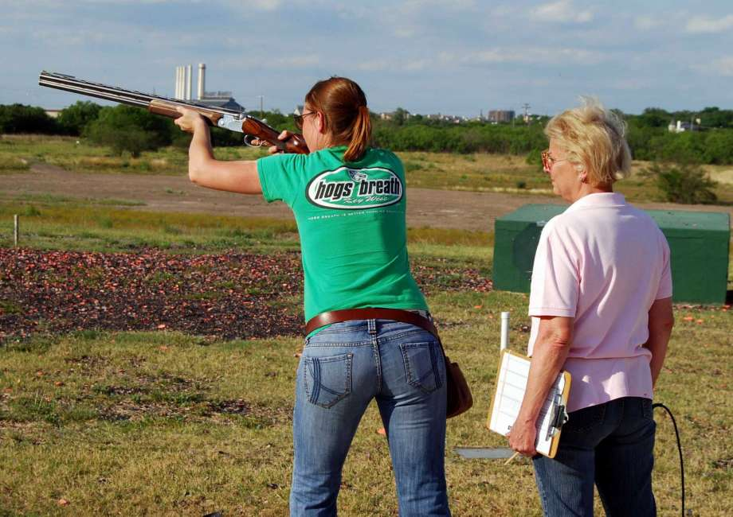
Problem
No automated scoring method for clay shooting sports (i.e. Skeet Shooting).
Current scoring requires individual with:
Exceptional eyesight
Knowledge about sport procedures and rules
Finding willing human referees is difficult
[1] Skeet Shooting Tournament.
Notes:
Philip
[Backup: Keith]

Slide 3
Importance of IC Chip
Difficult to see
clay target!
[2] Daytime.
Notes:
Keith

Slide 4
Importance of IC Chip, con.
[3] Nighttime.
Notes:
Keith

Slide 5
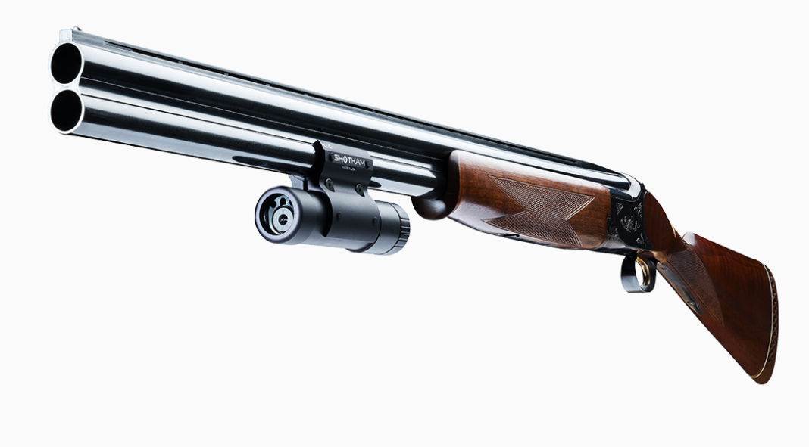
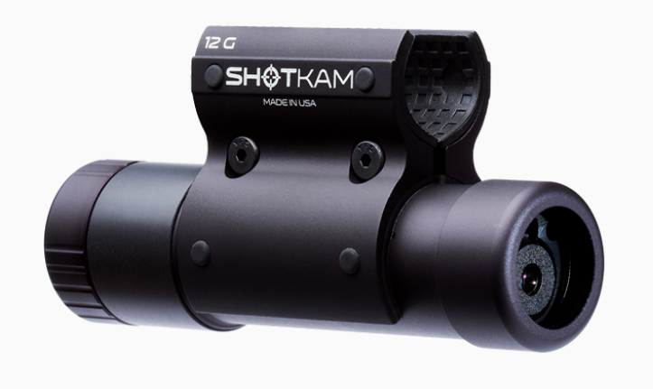
Importance of IC Chip, con.
Similar Product: ShotKam
Camera attached to shotgun barrel.
Accompanying mobile app.
Tracks barrel movement.
Slow-motion replay.
Why it won’t solve our problem:
Expensive ($695/ShotKam)
Have to reattach ‘kam’ to each shooter’s gun.
Camera too narrowly focused.
Does not classify targets!
[4],[5] ShotKam.
Notes:
Eva

Slide 6
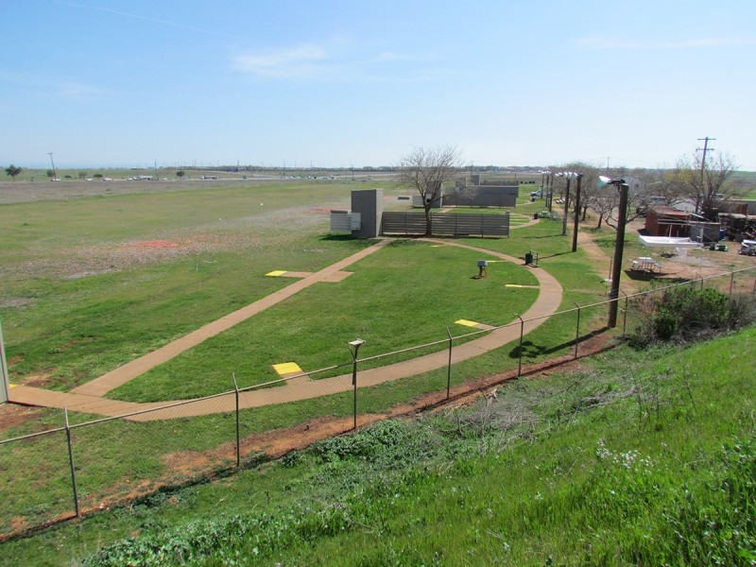
Operating Environment
Outdoor skeet shooting range
Various weather conditions
Strong wind v. light breeze
Day v. Night
Hazards:
Stray clay target pieces
Shotgun pellets
Range debris
[6] Skeet Shooting Field.
Notes:
Eva

Slide 7
UI/UX
Android Application:
User creates and starts Shooting Session.
User can challenge target classification.
User views shot video only if target challenged.
User can overturn target classification.
Ground Station:
User sets up ground station.
User powers on ground station.
*Majority of user interaction is with mobile application!
Notes:
Keith

Slide 8
System Conceptual Sketch
[7] System Conceptual Sketch.
Notes:
Steven

Slide 9
Functional Requirements: Ground Station
The physical device should…
Produce its own WiFi signal.
Be powered by an internal battery and no external power source.
Be accompanied by a protective, yet removable, “house.”
Classify a clay target as dead, loss with attempt, or loss without attempt.
Distinguish between a clay target fragment and shotgun wad or other debris.
Notes:
Eva
***Only presenting core project requirements

Slide 10
Non-Functional Requirements: Ground Station
The physical device will…
Perform computation and classify the clay target within 2 seconds of when the shot was made.
Send the target classification to the mobile application within 2 seconds of computation result.
Classify targets (human-visible breaks) with upwards of a 95% accuracy rate.
Notes:
Eva

Slide 11
Functional Requirements: Mobile Application
The mobile application should…
Display target classification on the screen once the shot classification has been determined.
Allow users to challenge a target classification.
Device should not store videos.
Connect to ground station via Wifi.
Notes:
Eva

Slide 12
Non-Functional Requirements: Mobile Application
The mobile application will…
Display the target classification within 1 second after the classification is received from the physical device.
Delete a video from memory within 1 second of a user finishing a challenge of the target classification.
Should not rely on internet, outside of the ground station’s WiFi signal, to perform all functionalities.
Notes:
Eva

Slide 13
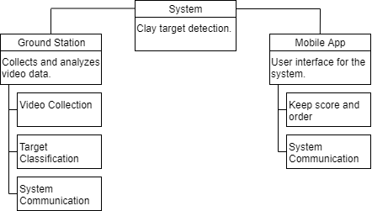
Functional Decomposition
[11] System Function Decomposition
Notes:
Cole

Slide 14
Technical Constraints
Time
The project is limited to 2 semesters.
Cost
Budget is $1000.
A low-cost solution is more ideal.
Hardware
Computation Complexity
Scope
Competency.
Notes:
Cole

Slide 15
Project Risks & Mitigation
Project Risks | Mitigation Strategy
Schedule risks - Falling behind in the schedule due to inaccurate time estimations. | Have a development processes in place that helps keep the team on task. Hold regular meetings.
Cost risks - Going over budget due to inaccurate cost estimations or unexpected events. | Make sure that the cost of all resources is accounted for. Leave room in case of emergency.
Hardware risks - Purchasing hardware that is incompatible with the project. | Have a good understanding of the hardware and components being purchased.
Object detection risks - Performance of the classifier doesn’t meet expectations. | Do plenty of training on the model and have a variety in the type of training data.
App development risks - Functionality doesn’t meet the needs of the client. | Test often. Have the users test the app and observe their feedback.
Notes:
Cole

Slide 16
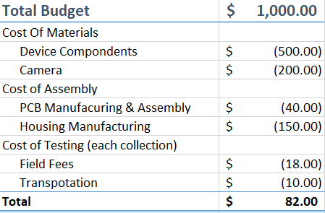
Project Cost Estimation
[10] Project Budget.
Notes:
Mike

Slide 17
Project Milestones
Project Requirements and planning
Clay target movement detection
Clay target object recognition (moderate accuracy)
Mobile app prototype
Camera device prototype
Mobile app and camera device communication
Clay target object recognition (high accuracy)
Project Fully Tested
We are here.
Notes:
Keith

Slide 18
Project Phases & Schedule
Requirements, Planning and Data Collection
Model Training and Data Labeling
Splicing Videos
Labeling Hit/Miss Boxes
Software/Hardware Development Process
Application Development
Hardware/Software Communication
Project Testing
Notes:
Keith

Slide 19
Notes:
Keith

Slide 20
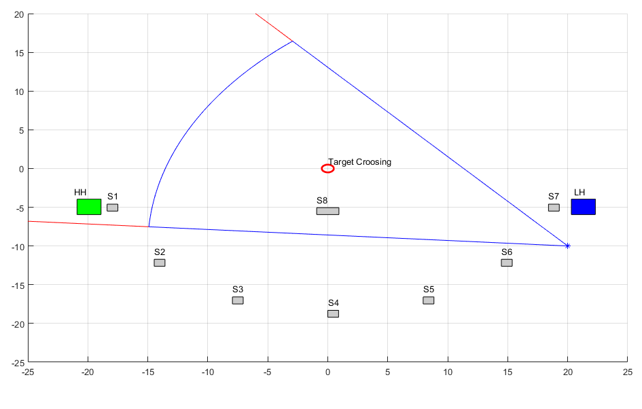
Camera Angle Simulation
A MATLAB program was created to help visually understand how a camera would operate on the field.
Takes in camera properties (field of view and depth of field) displays top down view of field.
Notes:
Mike - Camera Angle Simulation

Slide 21
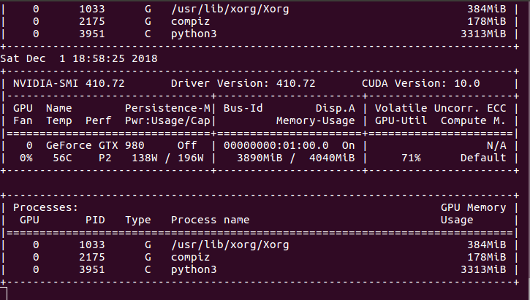
Hardware Platform Used
Current: Nvidia GTX 980
2048 CUDA Maxwell Cores
4 GB GDDR5
165 Watts
Future: Nvidia Jetson TX2
256 CUDA Pascal Cores
8 GB LPDDR4
15 Watts
Complete System
[12] CUDA Utilization Metrics
Notes:
Steven

Slide 22
Test Plan: Mobile Application
Use Mock Data for Mobile App Prototype
Control over data set
Control over data flow
Easier to validate test results
[13] Mobile Application Test Flow Diagram
View detailed test plan in Design Doc v2
Tests to ensure both functional and non-functional requirements are satisfied.
TDD Model
Notes:
Keith - “Mock Data”

Slide 23
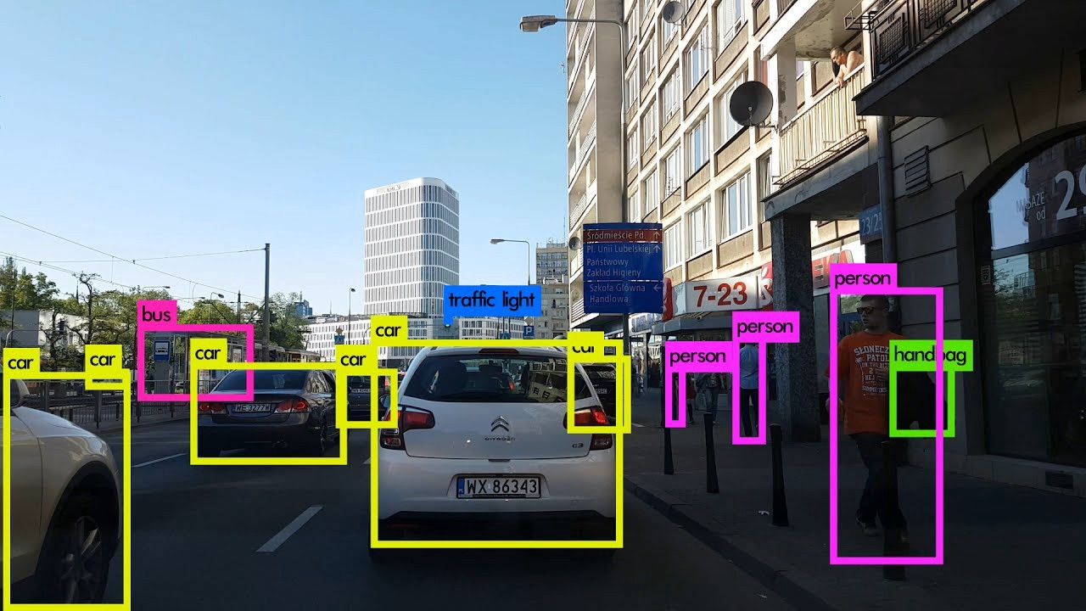
Test Plan: Target Detection Algorithm
You Only Look Once, version 3
State-of-the-art object detection and tracking
Highly-tunable hyperparameters to fit limited resource requirements
Extensible Python3 wrappers are commonly available
Effectively leverages large amounts of parallelism (CUDA)
[14] YOLA in Action
Notes:
Steven

Slide 24
Model Construction and Verification
[15] Standard data splitting for model training
Proper Dataset Usage
Split the data into three disjointed, randomized sets
Training set for learning the network
Validation set to estimate various properties such as error
Testing set to demonstrate performance on the network
Notes:
Steven - Training Data

Slide 25
Current Project Status
Data Collection and labeling
Collected 2 sets of video data.
Used FFMPEG and python for video editing and labeling.
Used OpenLabeling as a tool to draw bounding boxes.
Model Training
Only trained on first set of data collection
Poor performance so far, but has shown a better model is possible
Notes:
Cole - Data Labeling
Steven - Training Model

Slide 26
Individual Member Contribution
Eva Kuntz
Mobile Application requirements elicitation.
Hardware/Software test plans.
Keith Snider
Application Development
Mobile Application requirements elicitation.
Cole Huinker
Data collection lead.
Application Development.
Steven Sleder
Computer vision model construction
Data labelling documentation and organization
Michael Ruden
Philip Hand

Slide 27
Looking Forward...
Continued model training
Continue Application Development
Build mock data/testing functionalities
Ground Station to Application Communication
Hardware/Software consolidation
Implement test plan
Notes:
Eva, Steven, Keith

Slide 28
Questions?

